Slide 1



OpenSense Training School OS-based nowcasting with pysteps
Introduction to the nowcasting training session
Training instructors:
Jenna Ritvanen (Finnish Meteorological Institute) and Ruben Imhoff (Deltares)

Slide 2
Outline
When and why to use nowcasting
Introduction to nowcasting with pysteps
Nowcasting with OS data
Setup of this training session
Goal of this training session: To give a “hands-on” experience of using pysteps with conventional radar and OS data

Slide 3

When and why to use nowcasting

Slide 4
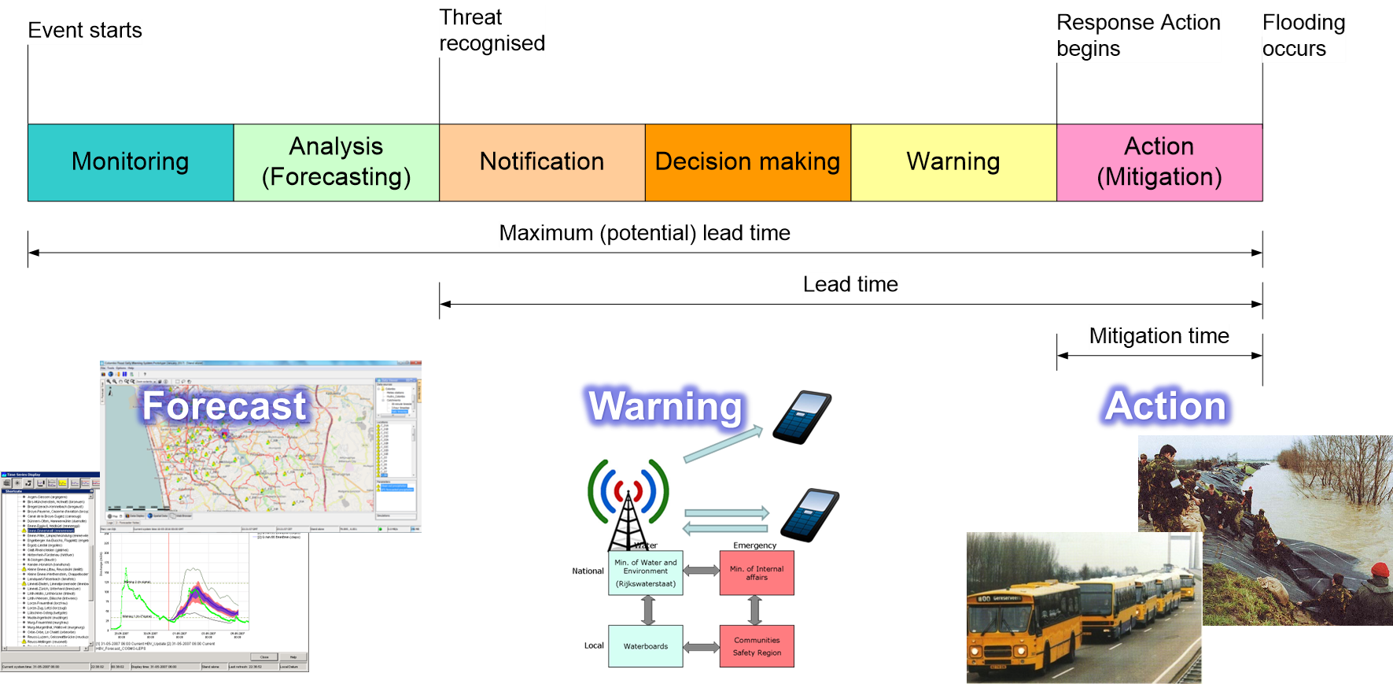
Forecasts, warning and action
Our domain!

Slide 5
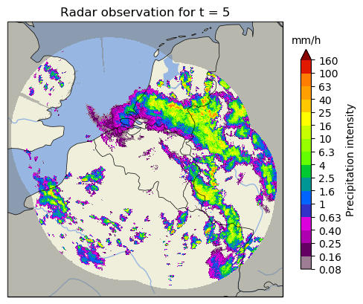
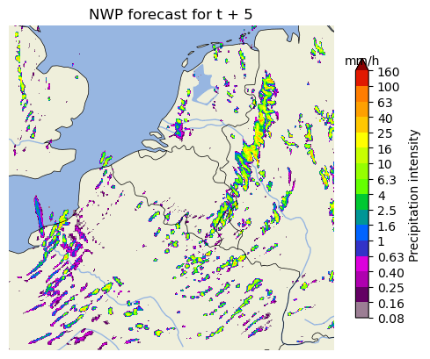
For short lead times Numerical Weather Prediction models are generally not sufficient
Discharge
Obs
Effect on discharge forecast
Forecast
Time

Slide 6
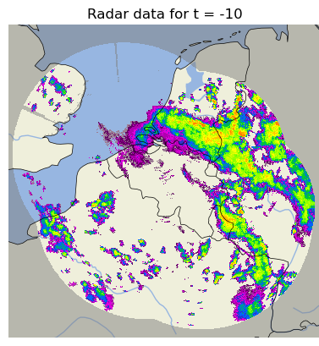
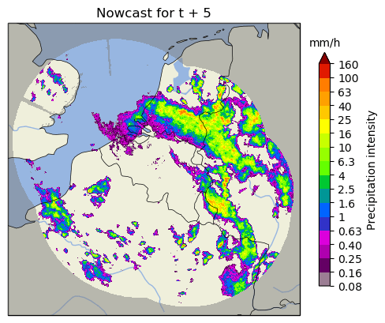
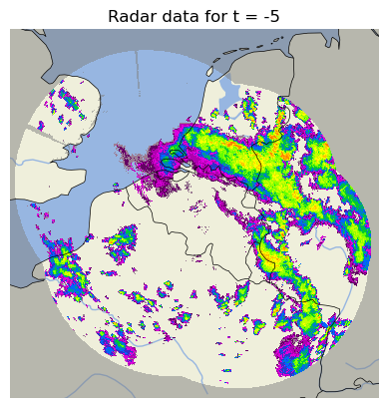
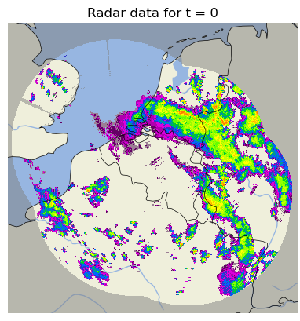
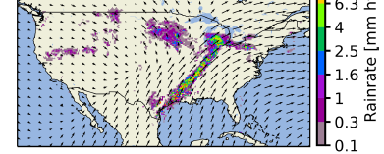
Nowcasting as a fast alternative for the short lead times
Statistical extrapolation
Fast!
But no physics involved..
Determine movement of rainfall fields
Rainfall field evolution
Add stochastic noise
Extrapolate to future and blend
Source: Pulkkinen et al., GMD, 2019

Slide 7
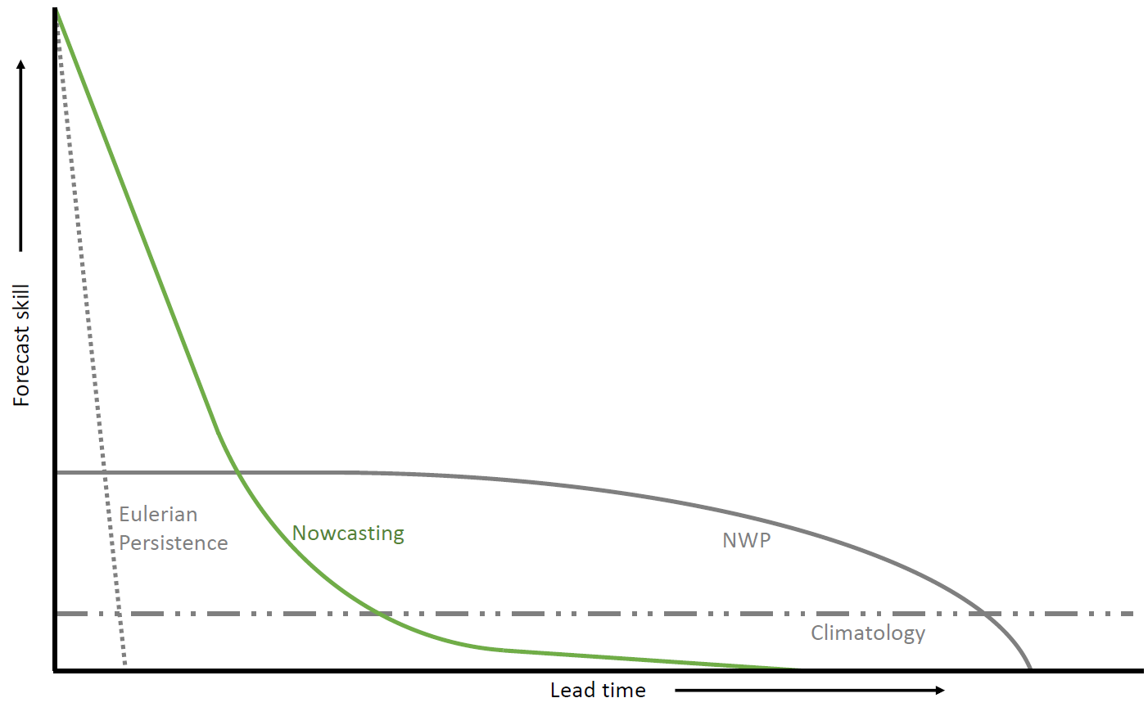
The skill of nowcasting

Slide 8
Introduction to nowcasting with pysteps

Slide 9
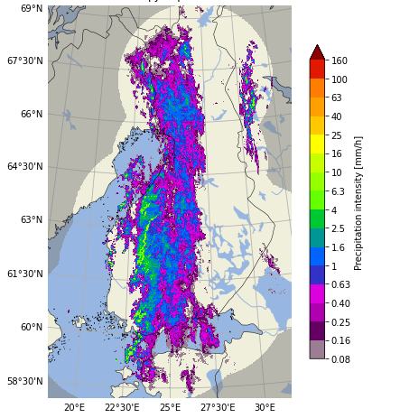
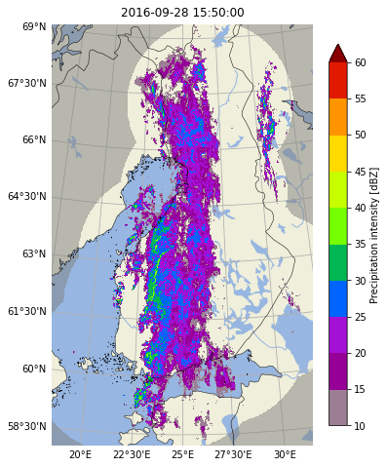
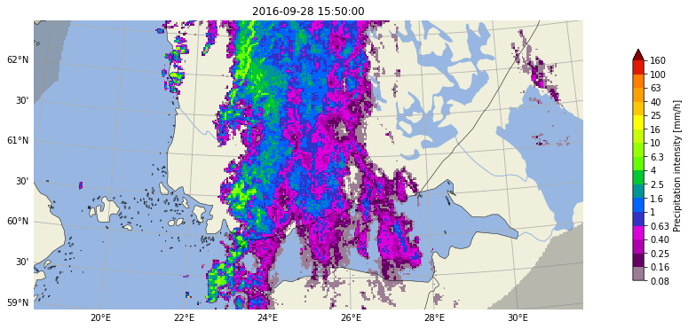
Input data
Transformations and conversions between units
pysteps uses gridded data as the main input data source
Often this consists of radar rainfall data.
Reading input data from various sources has been implemented in the io.importers module
To implement your own importers, you can use cookiecutter: https://pysteps.readthedocs.io/en/stable/developer_guide/importer_plugins.html or simply wrap it in an xarray reader.
The utils module contains different methods for converting, transforming, clipping and upsampling the input data
Helps you, but also the motion fields and noise generation in pysteps!
Clipping

Slide 10
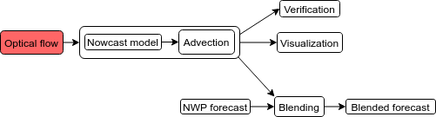
A typical workflow when using pysteps

Slide 11
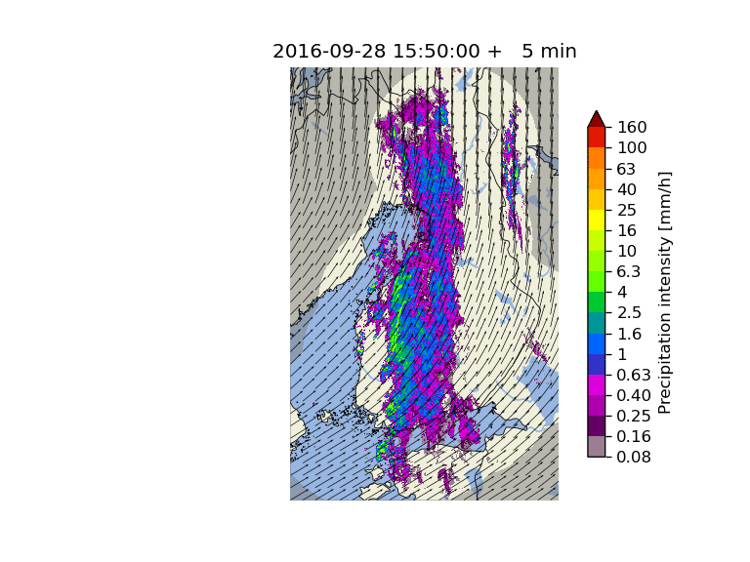
Optical Flow and Extrapolation
Advection (optical flow & extrapolation) is the key component of all pysteps nowcasting methods
All methods are based on the “Lagrangian persistence” nowcast shown on the right
Three different types of optical flow methods have been implemented in the motion module:
feature tracking: Lucas-Kanade
variational: VET and Proesmans
spectral: DARTS
For advection, pysteps implements the backward semi-Lagrangian scheme in the extrapolation module

Slide 12
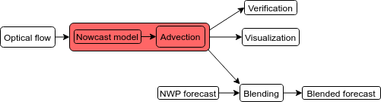
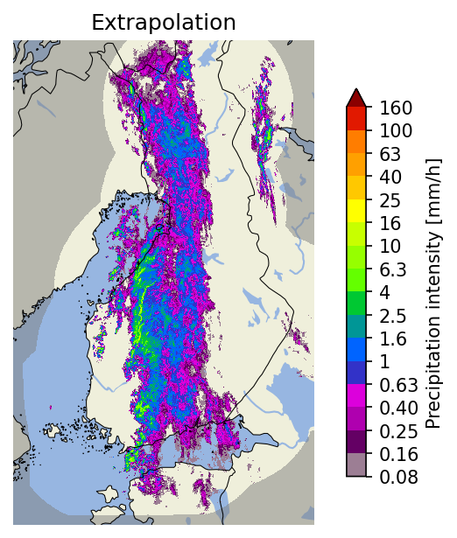
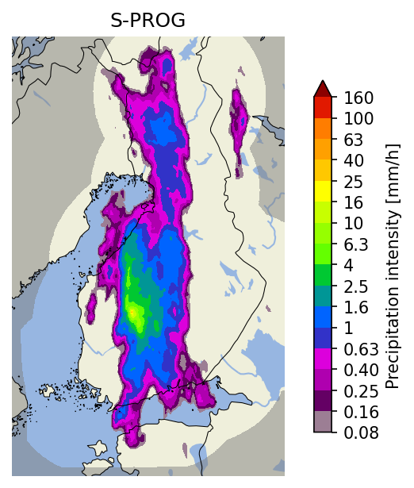
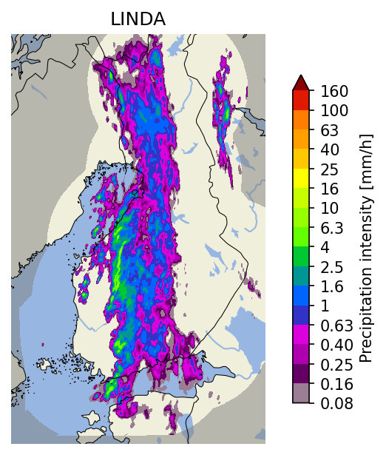
Deterministic Nowcasts
The main methods implemented in the nowcasts module:
Method | Pros | Cons | Typical computation time
Extrapolation | very fast | no prediction of growth or decay of precipitation | < 10 seconds
S-PROG | for low-intensity precipitation (< 1-2 mm/h) has generally the best skill choose for stratiform events | inability to preserve the spatial structure of rainfall fields, and particularly convective cells | < 20 seconds
LINDA-D | the most accurate method for intense precipitation (> 1-2 mm/h) choose for convective events | slow to compute | might take several minutes

Slide 13
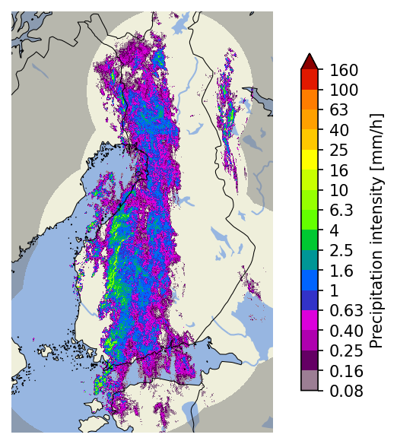
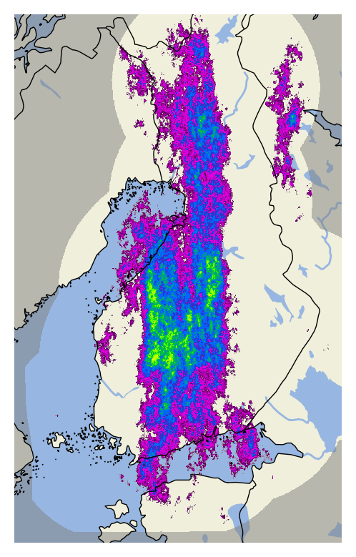
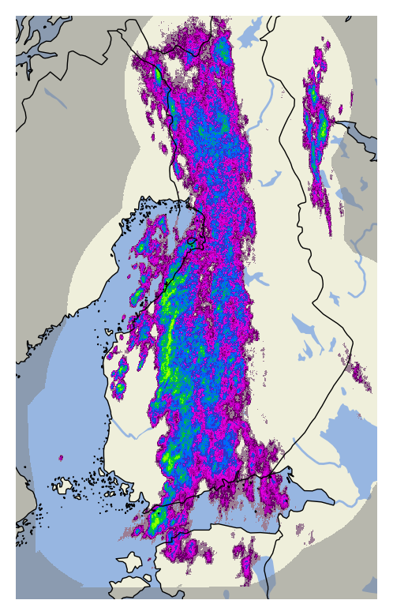
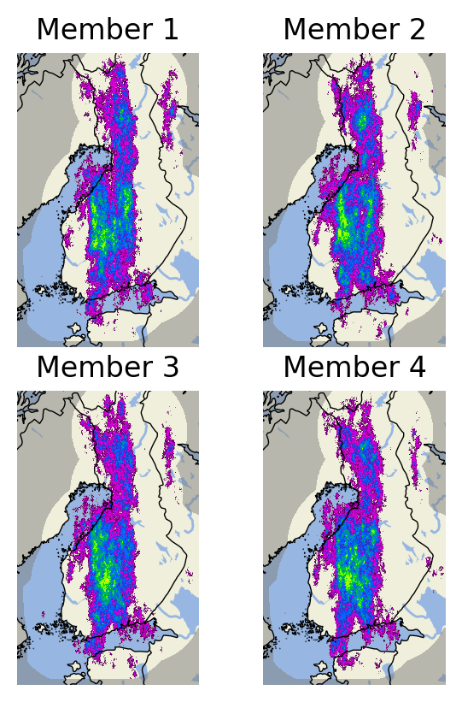
Ensemble Nowcasts
Observations at 2016-09-28 15:50 UTC
First ensemble members
STEPS
LINDA-P
The main ensemble methods implemented in the nowcasts module are STEPS and LINDA-P
They model two sources of uncertainty: advection field estimation and Lagrangian growth and decay
The basic rule for choosing the method:
stratiform events: STEPS
convective events: LINDA-P
LINDA-P generally produces more realistic ensemble members
Computation times for the 4-member ensembles shown on the right:
STEPS: ~20 seconds
LINDA-P: ~5 minutes
Nowcast ensemble

Slide 14
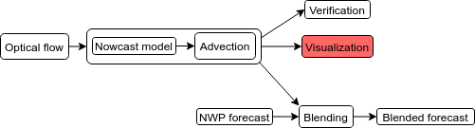
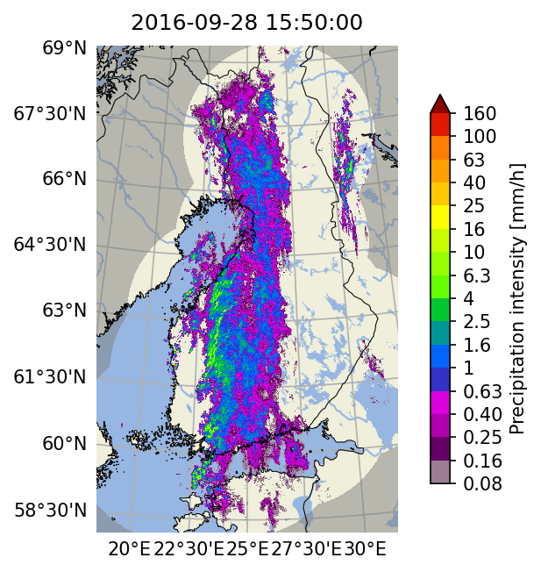
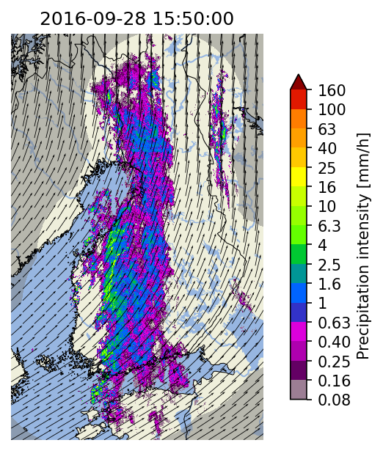
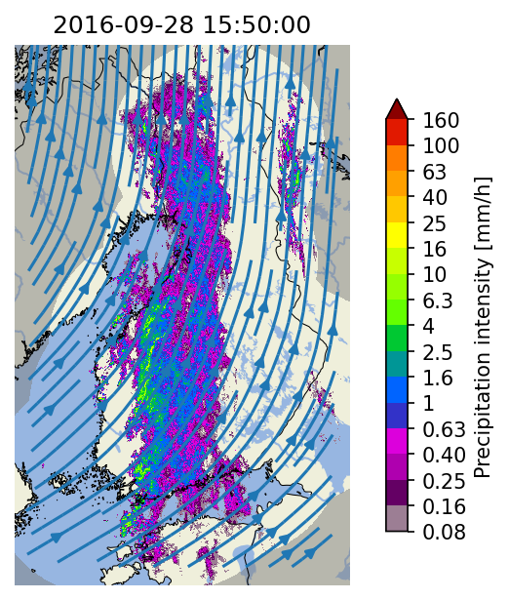
Visualization tools
Colorbars with several pre-configured scales and for different data units
Longitude-latitude lines with labels
Extensive set of visualization tools has been implemented in the visualization module
Support for multiple layers: basemap, precipitation and motion field:
plotting of basemaps by using cartopy
quivers and streamlines for advection fields

Slide 15
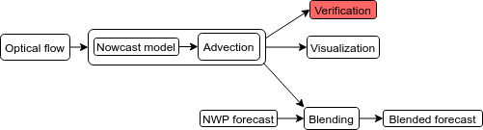
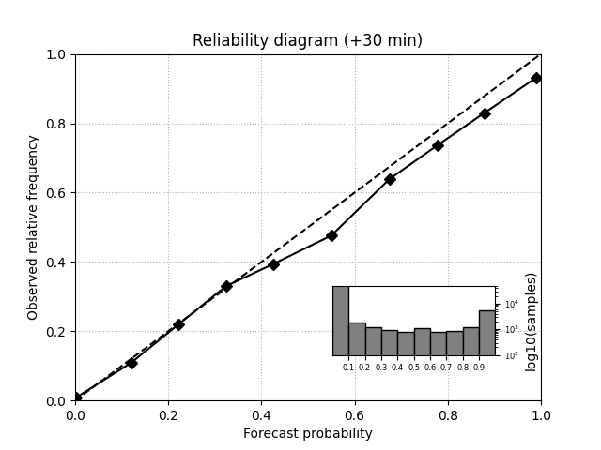
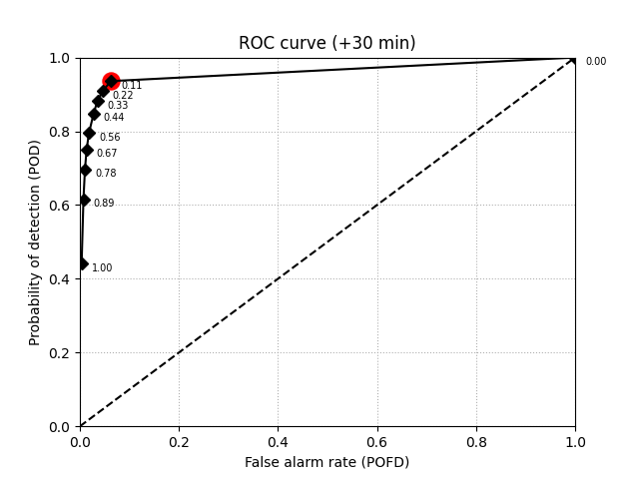
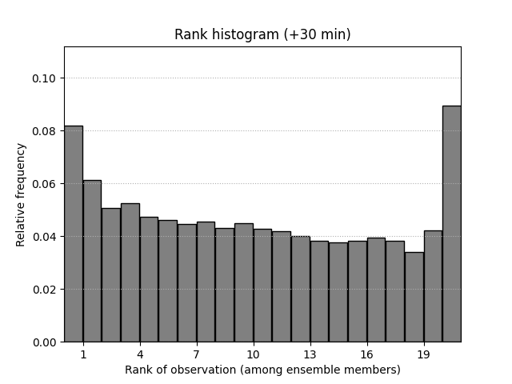
Verification tools & metrics
Examples of verification plots for
30-minute STEPS nowcasts
Metrics
A large number of verification utilities and metrics have been implemented in the verification module
Functionality
creation of verification objects and aggregation from multiple nowcasts
plotting of verification results
Deterministic
categorical: CSI, ETS, POD, FAR
continuous: MAE, ME
scale/intensity-based metrics: FSS, intensity-scale
radially averaged power spectral density (RAPSD)
Probabilistic
CRPS
reliability diagram
Ensemble
spread
rank histogram

Slide 16
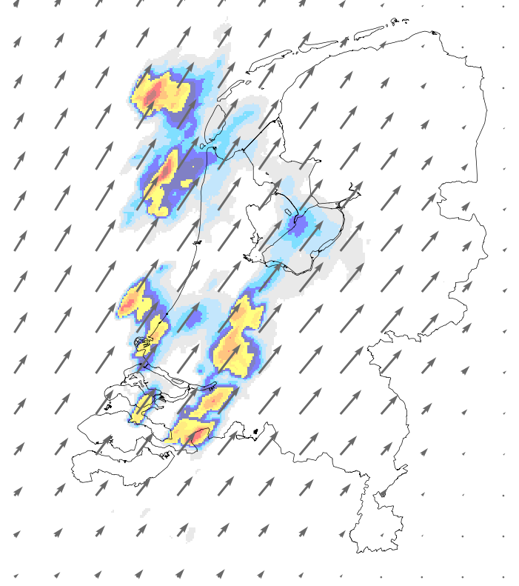
Nowcasting with OS data

Slide 17
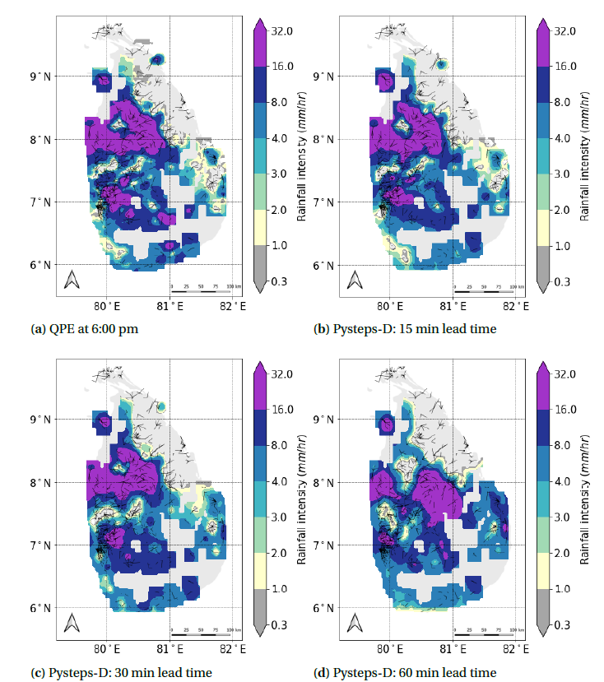
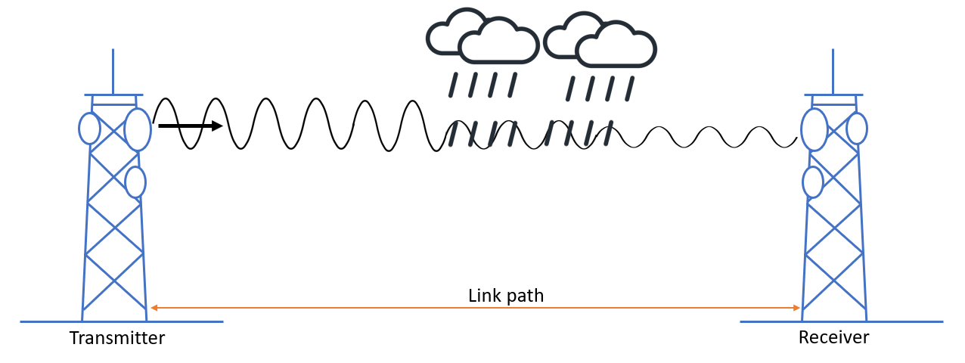
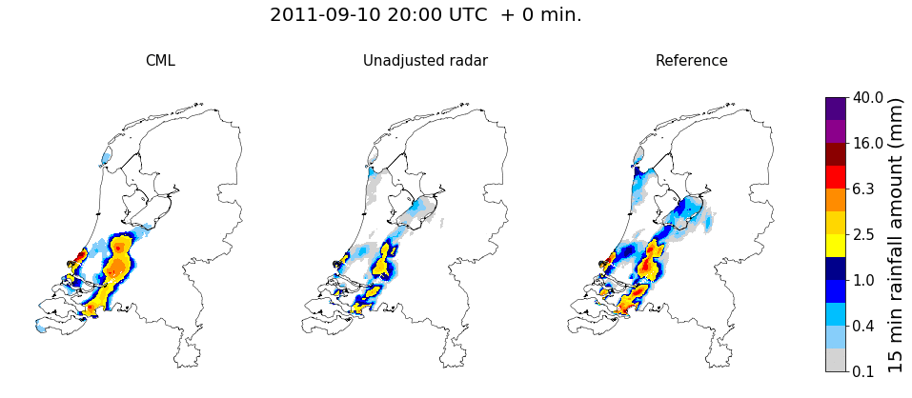
Rainfall nowcasting with alternative sensors
Schoenmaker, 2022
Imhoff et al., GRL, 2020
Schoenmaker, 2022 and current work of Bas Walraven (TU Delft)

Slide 18
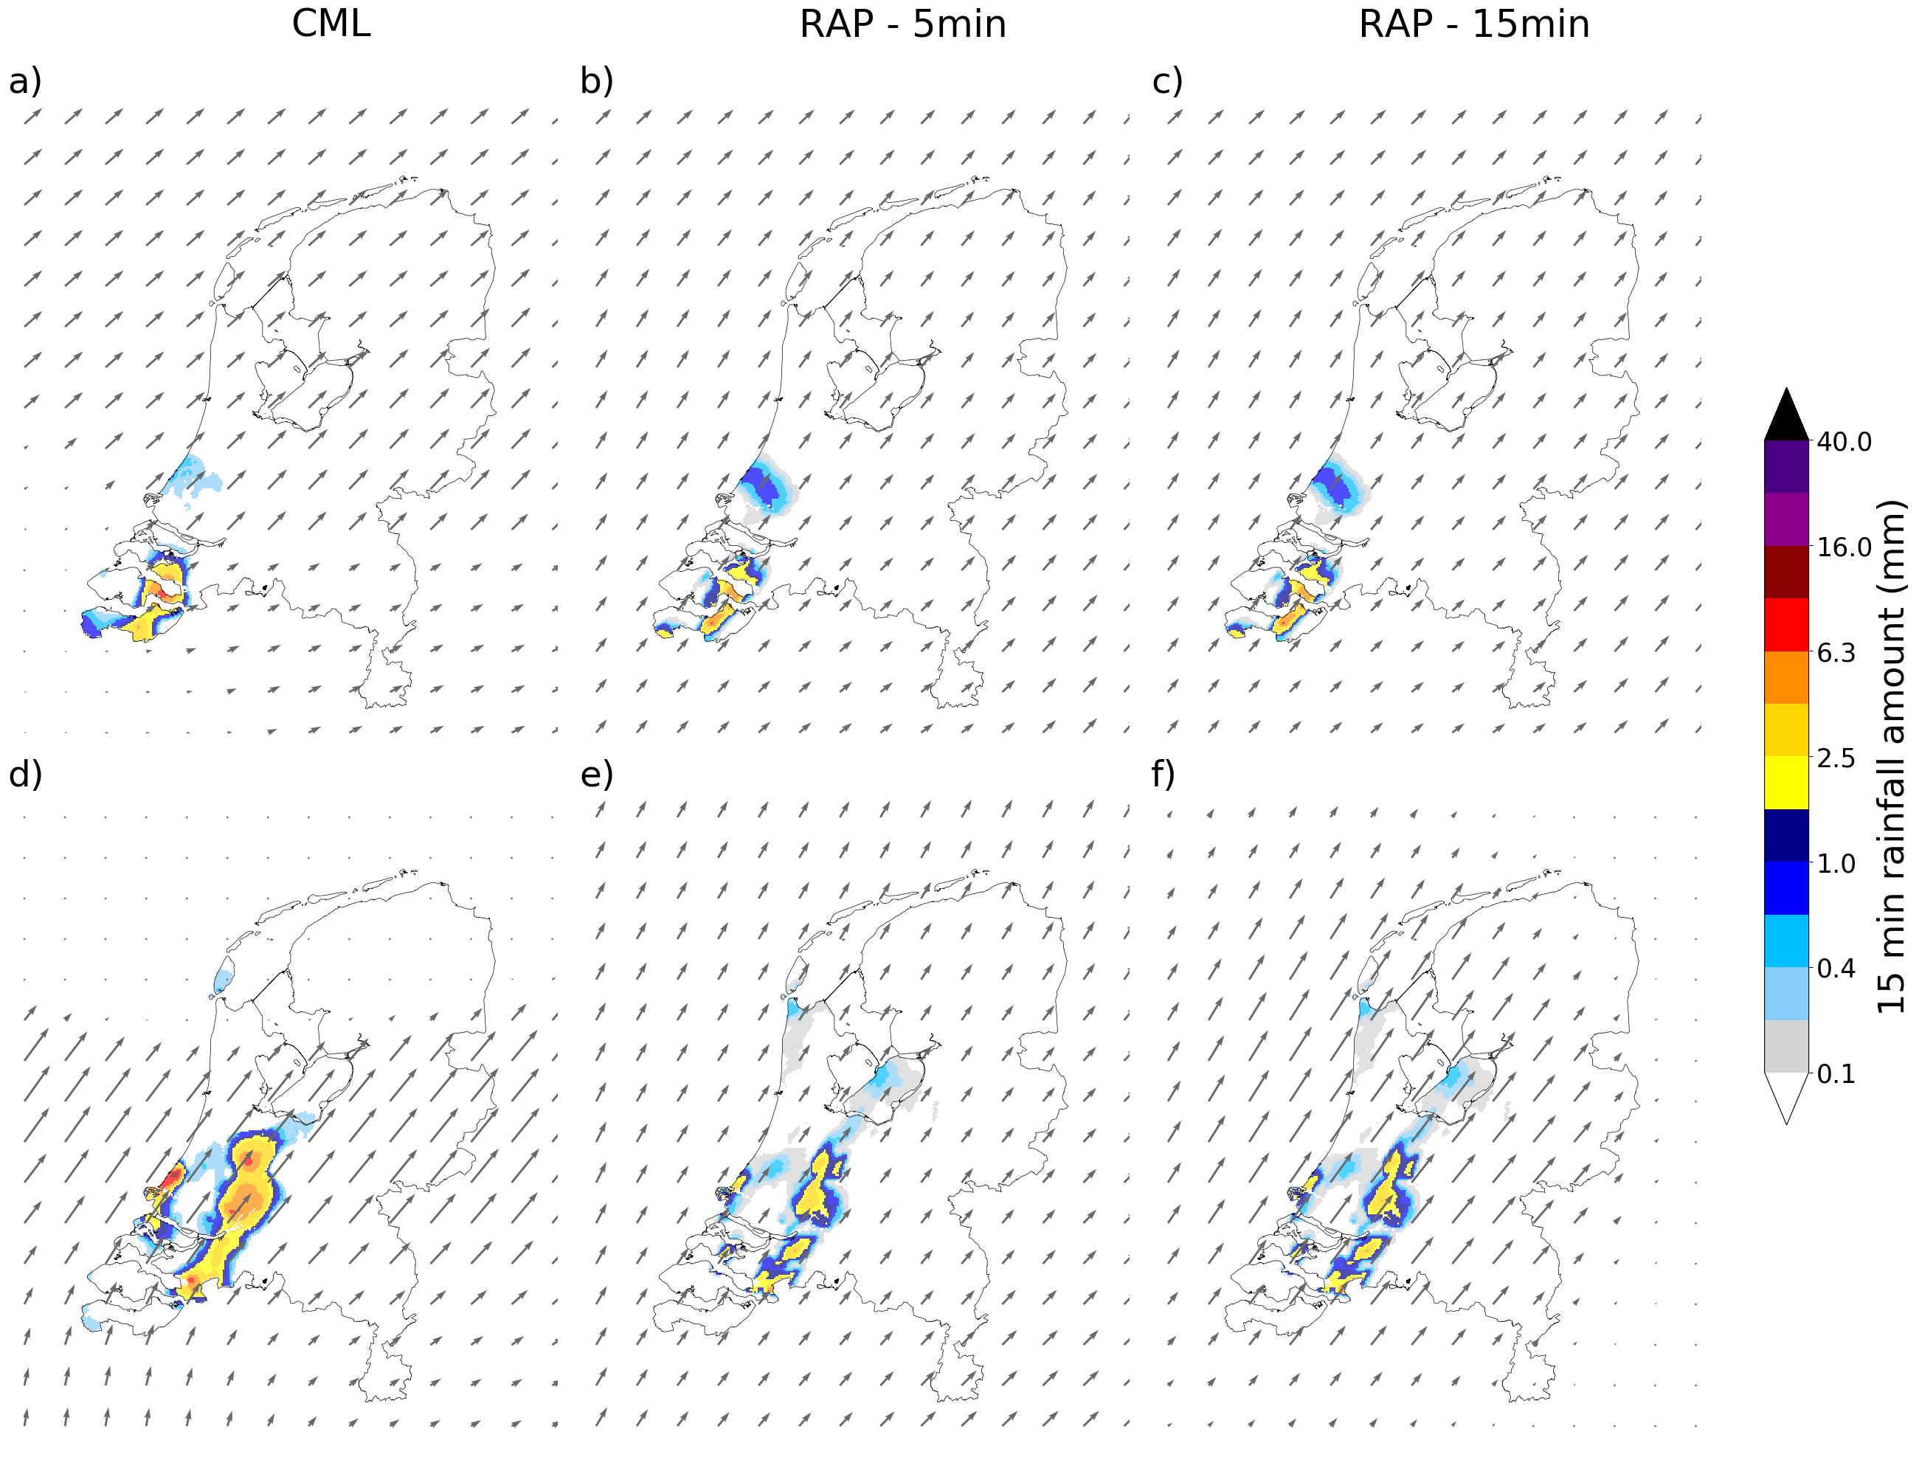
Challenges when nowcasting with OS data
Advection field derivation
Data consistency
Can you think of other possible issues when using OS data for nowcasting?
Request to you: have a close look at the differences in the optical flow fields, processing steps and resulting nowcasts between the various OS products that you are testing today.
CML
Radar (5 min.)
Radar (15 min.)
Imhoff et al., GRL, 2020

Slide 19
Setup of this training session

Slide 20
Hands-on experience through four exercises
Exercises:
Check pysteps installation and download example data
Read, visualize and process input data with pysteps
Optical flow and extrapolation
Optional: Advection correction of the gridded rainfall fields for accumulation.
Creating your first nowcasts with the OS datasets
Optional: Creating a probabilistic (ensemble) nowcast with the same datasets

Slide 21
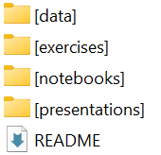
Setup of the training material
Nowcasting-session folder

Slide 22

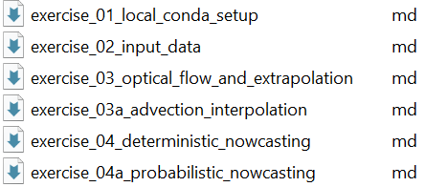
Setup of the training material
Nowcasting-session folder
This folder contains the description of each exercise

Slide 23
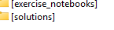
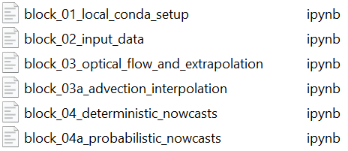
Setup of the training material
Nowcasting-session folder
These folders contain the notebooks in which you can work on the exercises (exercise_notebooks, which include some hints to get there) and the notebooks with the solutions.

Slide 24
Setup of the training material
Nowcasting-session folder
Finally, all presentations of this session can be found in this folder

Slide 25
Time to try it out yourself! Schedule: - Introduction to the session (25 minutes) - Hands on: Getting started with pysteps, read, visualize and process the radar and opportunistic sensing data. (20 minutes) - Hands on: Optical flow and extrapolation, the base of advection-based nowcasting. (30 minutes) - Wrap up of the first hands-on sessions. (10 minutes) - Hands on: Your first nowcasts, using and verifying radar and opportunistic sensing data for nowcasting. Additional, if time allows, creation of ensemble nowcasts. (60 minutes) - Wrap up and closure. (15 minutes)

Slide 26
No to forget, update opensense_training python package:
git add *
git commit -m "day2 changes part 1“
git fetch
git merge origin/main
# A screen will pop up about committing your changes, do the following:
:wq [then press enter]

